Slide 1
Software Architecture- II
CSE-861 Software System Design & Architecture

Slide 2
Why software architecture?
Communication among stakeholders
Early design decisions
  Implementation Constraints
  Organizational Structure
  SA as system quality enabler
  Managing Cost
  Evolutionary Prototyping
  Cost and Schedule Estimation
Transferable abstraction of a system
  Software Product Lines
  Large, externally development elements
  Restrict alternate design

Slide 3
Importance of Software Architecture
Communication among stakeholders
  SA presents a common abstraction of a system
  Customers are concerned that
    Software is reliable and available
    Architecture can be implemented on schedule and within budget
    SA allows teams to work independently

Slide 4
SA for early design decisions
Implementation constraints
  Implementation must follow the structural design decisions
  Describe prescribe(suggest) elements, their interaction and the responsibilities
  Resource allocations as constraints on implementation
Organizational structure
  SA defines the highest level system decomposition
  This is used for the work breakdown
  Planning, budgeting, scheduling, teams, communication channels, configuration management etc.

Slide 5
SA for early design decisions …
SA as system quality enabler
  Architecture defines whether a system will inhibit the desired/required qualities or not
    High performance – manage time base behavior of the elements
      Inter-element communication ?
    Modifiability – responsibilities to elements
    Security – inter-element communication and access control
    Scalability – localization of resources
    Incremental release – manage inter-component usage
    Re-usability – restrict inter-element coupling

Slide 6
SA for early design decisions …
Managing change
  80% of the cost is after initial deployment
  Change can be partitioned into 3 groups:
    Local: modify a single element
    Non-local: multi-element change
    Architectural: change the way elements interact with each other
  Deep understanding of the relationships, performance and behavior of the system is required to decide on such changes

Slide 7
SA for early design decisions …
Evolutionary prototyping
  An executable system in the early DLC
Cost and schedule estimation
  Team/work distribution more clear
  Identify challenging parts
  Identify required resources/competencies

Slide 8
SA as a Transferable, re-usable model
Software Product lines
SPL is a set of software-intensive systems sharing a common, managed set of features that satisfy the specific needs of a particular market segment
These are developed from a common set of core assets in a prescribed way
Architecture: important asset
Architecture defines what is fixed for all members of a product line/family and what is variable
Architecture a core asset of the developing organization
Notes:
POS systems is a product line of a company selling it to different retailers (food marts, fashion retailers, fast-food chains etc.)

Slide 9
SA as a Transferable, re-usable model …
Large, externally developed elements
Architecture based development focuses on composing or assembling of independent elements
Architecture defines what type of elements can be incorporated into the systems along with any constraints (protocols, data types, procedures, interaction with external/internal environment etc)
Interchangeability – challenging in software systems due to architectural mismatch

Slide 10
SA as a Transferable, re-usable model …
Restrict design alternatives
  Restrict to a limited no. of choice for program cooperation and interaction
    Minimise design complexity
  Architectural pattern should help in arbitration of confliction design constraints and improve the implementation of the resulting design solution

Slide 11
Types of Architectural Structures
Module structure
  The elements are modules – units of implementation
  Modules represent a code-based way of considering the system.
  They assigned areas of functional responsibilities
  Can answer questions as:
    What is the primary functional responsibility assigned to each module?
    What other software elements is a module allowed to use?
    What modules are related to other modules by generalization or specialization (i.e., inheritance) relationships?

Slide 12
Types of Architectural Structures …
Component-and-connector structures
  elements are runtime components (which are the principal units of computation) and
  connectors (which are the communication vehicles among components)
  Can answer questions as:
    What are the major executing components and how do they interact?
    What are the major shared data stores?
    Which parts of the system are replicated?
    What parts of the system can run in parallel?
    How does data progress through the system?
    How can the system's structure change as it executes?
Notes:
Components are also called filters
Connectors are the pipes

Slide 13
Types of Architectural Structures …
Allocation structures
  Allocation structures show the relationship between the software elements and the elements in one or more external environments in which the software is created and executed
  Can answer questions like:
    What processor does each software element execute on?
    In what files is each element stored during development, testing, and system building?
    What is the assignment of software elements to development teams?

Slide 14
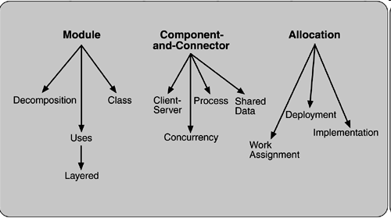
Common software architecture structures

Slide 15
Three Structures as three broad types of Decision
These three structures correspond to the three broad types of decision that architectural design involves:
  How is the system to be structured as a set of code units (modules)?
  How is the system to be structured as a set of elements that have runtime behavior(components) and interactions (connectors)?
  How is the system to relate to non-software structures in its environment (i.e., CPUs, file systems, networks, development teams, etc.)?

Slide 16
Module based structures
Decomposition
  Relationship between modules is “is a sub-module of”
  The decomposition structure enhances system‘s modifiability – changes fall in a small number of modules
  The modules have associated products (interface specifications, code, test plans etc)
Uses
  The units are modules or procedures or resources on the interfaces of modules.
  One unit uses another if the correctness of the first requires the presence of a correct version of the second.
  Extend or abstract (extract) functionality

Slide 17
Module based structures …
Layered
  a system of layers emerges(occur) when uses relationship is controlled in a particular fashion
    in which a layer is a coherent set of related functionality.
  In strict sense : layer n may only use the services of layer n – 1.
  Layers are often designed as abstractions (virtual machines) that hide implementation specifics below from the layers above – portability
Think of an example?

Slide 18
Module based structures …
Class or generalisation
  The module units in this structure are called classes
  The relation is "inherits-from" or "is-an-instance-of."
  This view supports reasoning about collections of similar behavior or capability

Slide 19
Component-and-Connector
Process or communicating processes
  deals with the dynamic aspects of a running system
  The units here are processes or threads that are connected with each other by communication, synchronization, and/or exclusion operations.
  The relationship is of attachment, showing how the components and connectors are hooked together
  It is important to design a system's execution performance and availability.

Slide 20
Component-and-Connector …
Concurrency
  A structure which allows the architect to determine opportunities for parallelism and the locations where resource contention(conflict) may occur
  The units are components and the connectors are "logical threads."
    A logical thread is a sequence of computation that can be allocated to a separate physical thread later in the design process.
Shared data, or repository(source)
  components and connectors that create, store, and access persistent data

Slide 21
Component-and-Connector …
Client-server
  A structure of components and connectors for a system built as a group of cooperating clients and servers
  The components are the clients and servers
  the connectors are protocols and messages they share to carry out the system's work
  Useful for
    separation of concerns
    for physical distribution, and
    for load balancing (supporting runtime performance).

Slide 22
Allocation
Deployment
The deployment structure shows how software is assigned to hardware-processing and communication elements
  The elements are software (usually a process from a component-and-connector view), hardware entities (processors), and communication pathways.
  Relations are "allocated-to,"
    which physical units the software elements reside,
    "migrates-to," if the allocation is dynamic

Slide 23
Allocation …
Implementation
This structure shows how software elements (usually modules) are mapped to the file structure(s) in:
  system's development,
  integration, or
  configuration control environments.
Helpful in the management of development activities and build environment

Slide 24
Allocation …
Work Assignment
This structure assigns responsibility for implementing and integrating the modules to the appropriate development teams
Work assignment structure has architectural as well as management implications

Slide 25
Which structure to choose?
Not all of them may be relevant
one of the obligations(Duties) of the architect is to understand how the various structures lead to quality attributes
Can you relate the 4+1 approach from the Rational Unified Process ?

Slide 26
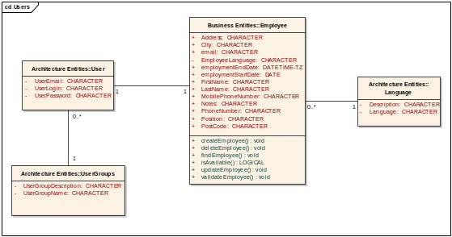
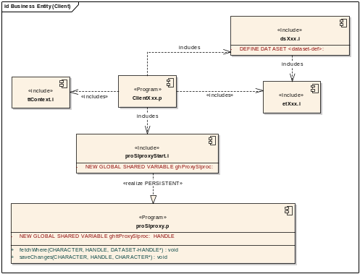
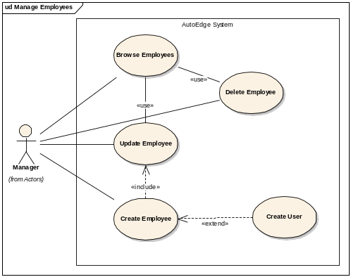
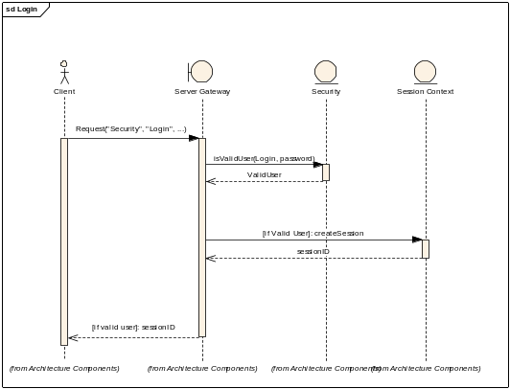
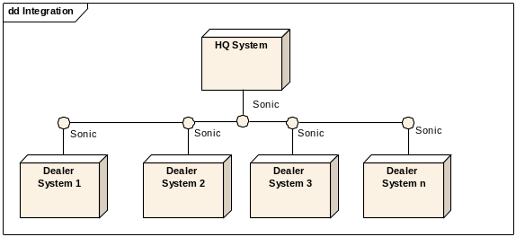
Logical View
Implementation View
Use Case View
Dynamic View
Deployment View

Slide 27
4 + 1 View
Logical. The elements are "key abstractions," objects or object classes
Process. This view addresses concurrency and distribution of functionality.
Development. This view shows the organization of software modules, libraries, subsystems, and units of development.
Physical. This view maps other elements onto processing and communication nodes

Slide 28
References and further readings
Chapter 2 from “Software Architecture in Practice” by Len Bass

